Slide 1
Parallel Programming in Distributed Systems
Lecture 13

Slide 2
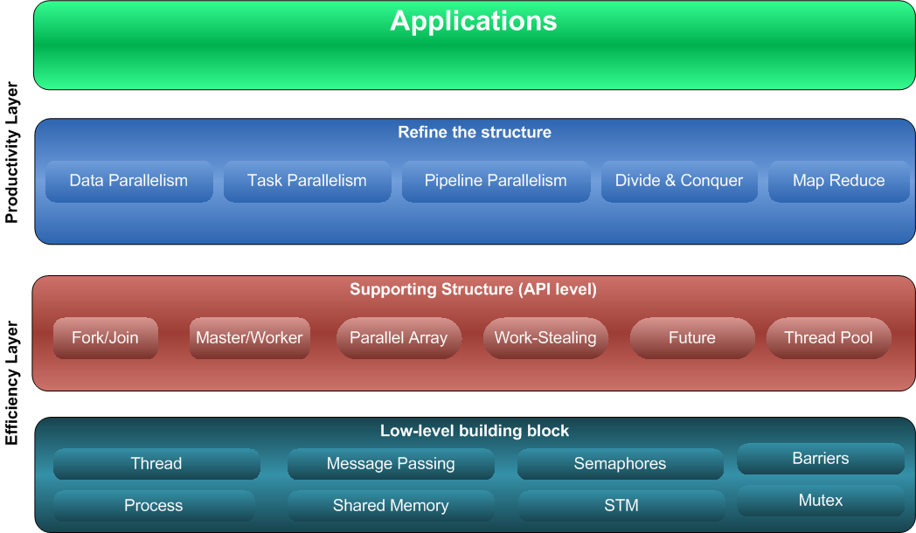
Parallelism building blocks

Slide 3
Programming Models

Slide 4
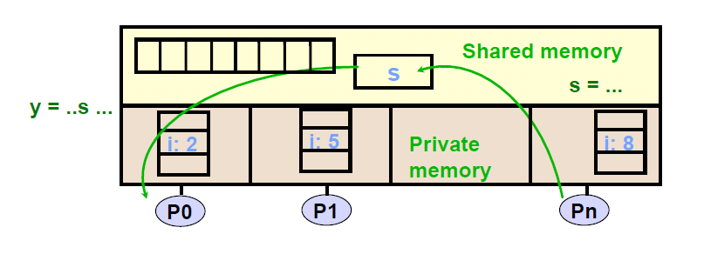
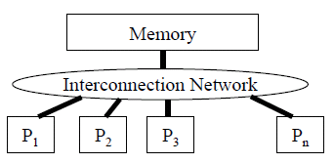
Programming Model 1 : Shared Memory
Multiple threads communicating through memory.
Threads communicate implicitly by writing and reading shared variables.
Atomicity, locking and synchronization for correctness.
Many scalability issues – deadlocks, starvation, race condition

Slide 5
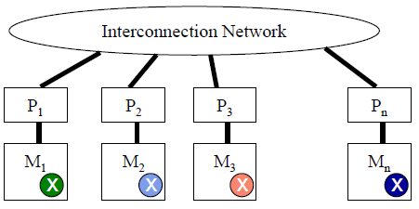
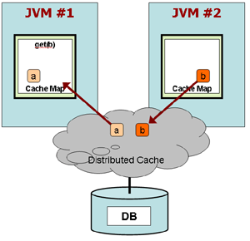
Programming Model 1 : Distributed Memory
Explicit data exchange between processors/nodes/JVMs)
Data distribution and communication orchestration is essential for performance.

Slide 6
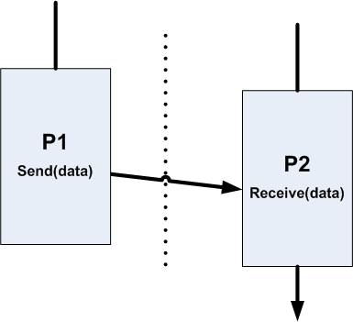
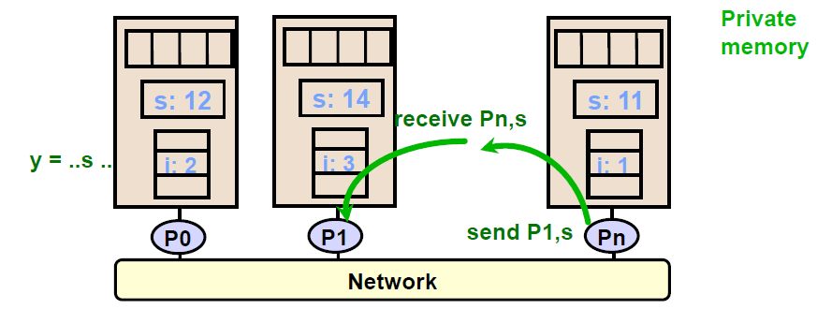
Programming Model 2 : Message Passing
Shared nothing.
Processes communicate by explicit send-receive pairs
De facto standard for parallel computing
Actor Model – supports in Actor (Scala & Java), Erlang, etc..

Slide 7
Shared Memory or Message Passing?
Depends on the program!
Can build Shared Memory with Message Passing and vice-versa
Advantages of Shared Memory
Advantages of Message Passing
Implicit communication
Low overhead when cached
Explicit communication (send/receive)
Easier to control data placement
Disadvantages of Shared Memory
Disadvantages of Message Passing
Complex to build scalable system
Requires synchronization
Hard to control data placement within caching system
Message passing overhead can be quite high.
More complex to program
Introduces question of reception technique (interrupts/polling)

Slide 8

What is a sequential program?
A single process or thread that executes instructions in order.

Slide 9
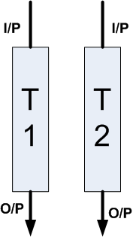
Bernstein’s Condition to parallelize
Two tasks T1 and T2 can run in parallel
IF
input_to_T1 != output_from_T2
AND
input_to_T2 != output_from_T1
AND
output_from_T1 and T2 do NOT overlap

Slide 10
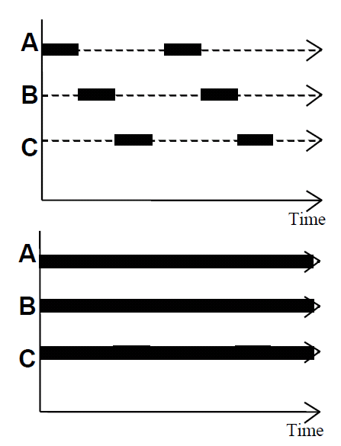
Concurrency vs. Parallelism
Concurrency
Gives “illusion” that multiple tasks running at same time.
Interleaves execution
Parallelism
Physically simultaneous processing
Requires a multicore system

Slide 11
Design Patterns

Slide 12
SPMD pattern
Single Program Multiple Data: the same program runs against multiple data on each processor or node.
Initialize
Split data correctly and evenly
Run the same program
Combine the results
Finalize
Not supported for dynamic load balancing

Slide 13
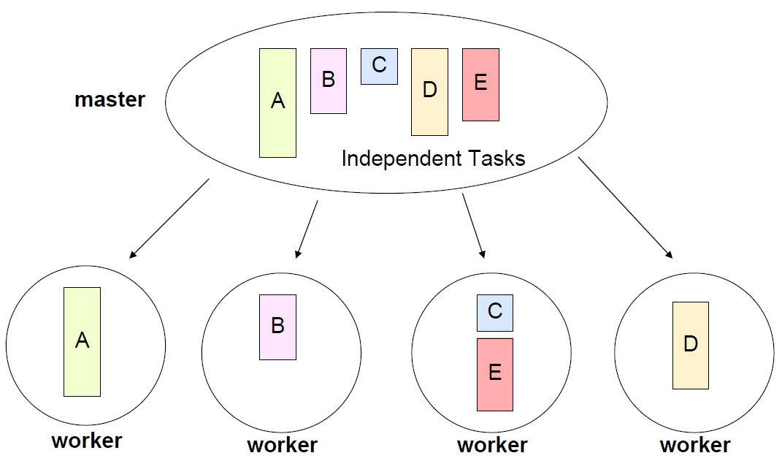
Master-Worker Pattern
Particularly relevant for problems using task parallelism pattern where task have no dependencies
Embarrassingly parallel problems
Main challenge is determining when the entire problem is complete

Slide 14
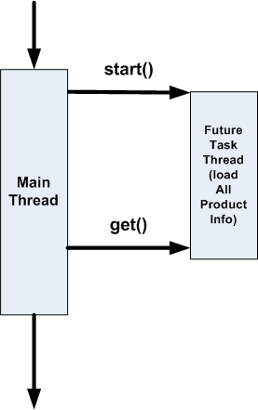
Future/Defer
Future can be used to load lengthy computation that can be started before the results are needed.

Slide 15
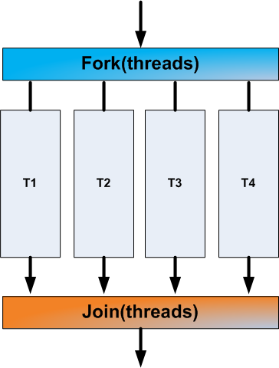
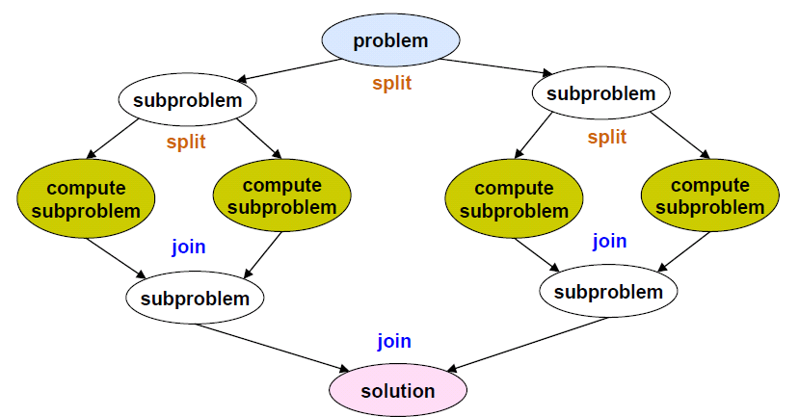
Fork-Join pattern
Supports divide-and-conquer pattern.

Slide 16
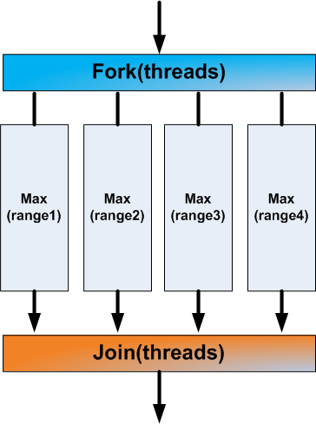
Fork-Join Framework

Slide 17
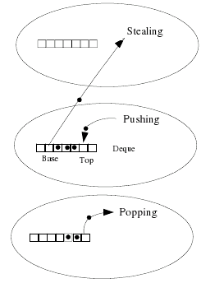
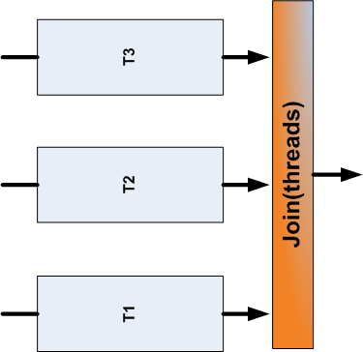
Under the hood 🡪 Fork-Join uses Work-Stealing

Slide 18
Fork-Join Parallel Array Performance
Less is Better
Best Case
Employees
Num Threads
(Running on Core 2 Quad System)
src - http://www.ibm.com/developerworks/java/library/j-jtp03048.html

Slide 19
Major Organizing Principles
How to choose a design pattern that facilitates the mapping of tasks to units of execution?
1. Organize by tasks
2. Organize by data decomposition
3. Organize by flow of data

Slide 20
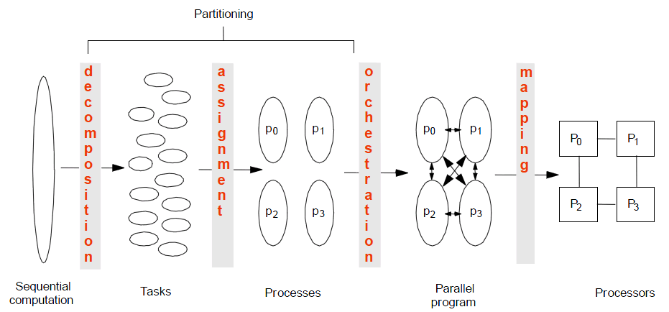
4 Steps to Creating a Parallel Program

Slide 21
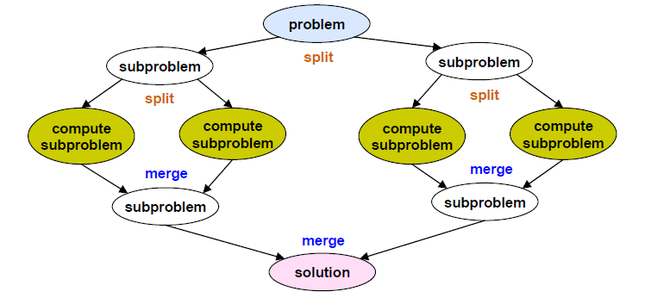
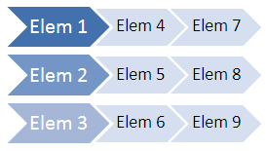
Data Parallelism
Perform same computation, but operate on different data.
How to divide data?
Array data structure – by rows, columns or blocks
Recursive data structure – trees into sub-trees
Thread 0
Thread 1
Thread 2
Time 🡪

Slide 22
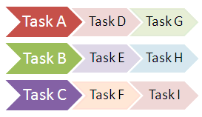
Task Parallelism
Each execution process (thread) performs different functions on same or different data.
Thread 0
Thread 1
Thread 2
Time 🡪

Slide 23
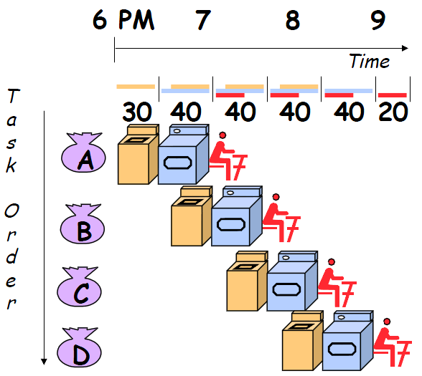
Pipeline Parallelism
Wash(30min) + dry(40min) + fold(20min) = 90 min (Latency)
Sequential exec = 4 * 90 min = 6 hrs
Pipelined exec = 30 + 4*40 + 20 = 3.5 hrs
Bandwidth = loads/hr
4/6 < 4/3.5
Bandwidth up!
But still the same latency

Slide 24
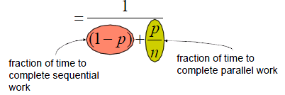
Amdahl’s Law
A program can be sped up by adding computing resources, based on proportion of serial and parallelizable components.
p = fraction of work that can be parallelized
n = the number of processor
Speedup = old running time
new running time

Slide 25
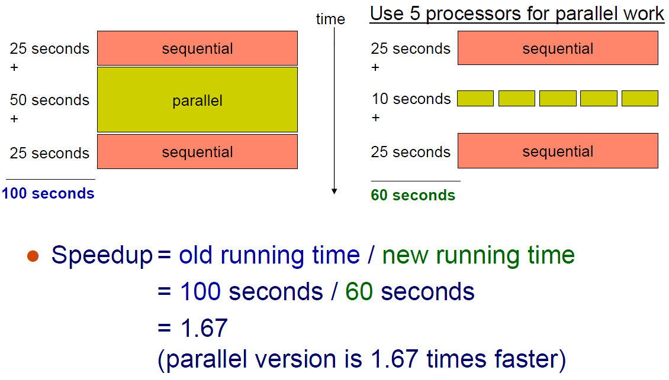
Amdahl’s Law Example

Slide 26
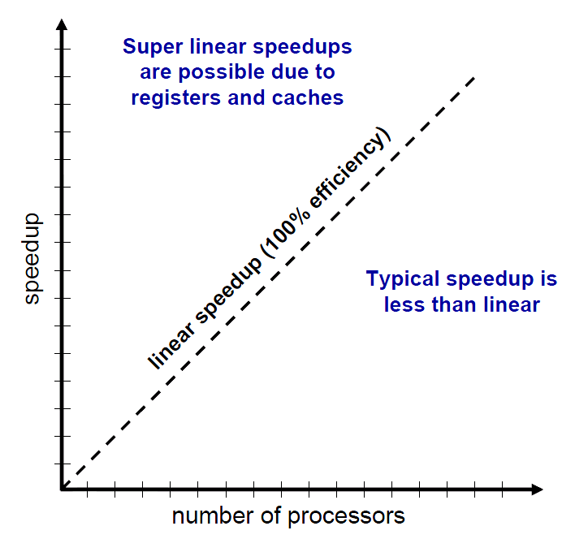
Performance Scalability

Slide 27
3 Keys to Parallel Performance
Coverage of parallelism in algorithm
Amdahl’s Law
Granularity of partitioning among CPUs.
Communication cost and load balancing
Locality of computation and communication
Communication between CPUs or between CPUs and their memories.

Slide 28
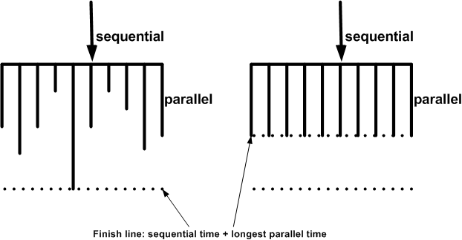
Single Thread Performance
Two keys to faster execution
Load balance the work among processors.
Make execution on each processor faster

Slide 29
Performance Considerations
For computation-intensive (CPU-bound) tasks that do no I/O and access no shared data,
N_{cpu} or N_{cpu} + 1 threads 🡪 optimal throughput
More threads can degrade performance as the threads compete for CPU and memory resources.
Load balancing factors
Tasks costs
all tasks have equal (unit) cost or not?
Tasks dependencies
tasks can execute in any order or have a predictable/dynamic structure?
Locality
Zero, regular, irregular communications among tasks

Slide 30
Ask yourself!
What do you mean by “faster”?
Under what conditions will this approach actually be faster?
Under light/heavy load?
With large/small data sets?
How often are these conditions likely to arise in your situation?
Is this code likely to be used in other situations where the conditions may be different? Average-case time or worst-case time?
What hidden costs—safety, increased development or maintenance risk– are you trading for this improved performance? Is this a good tradeoff?

Slide 31
“Avoid premature optimization. First make it right, then make it fast—if it is not already fast enough.” by Brian Goetz

